Slide 1
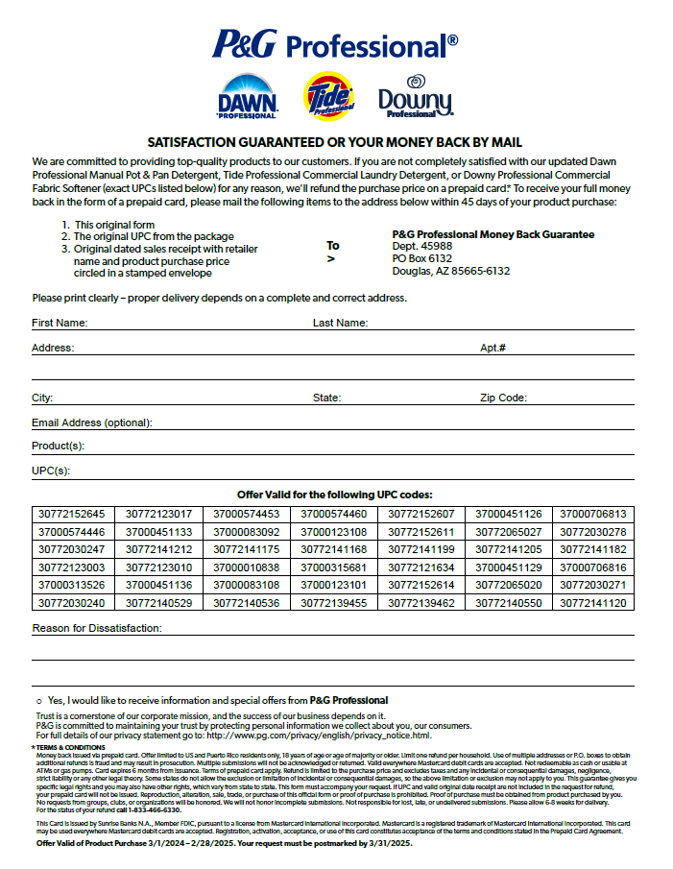
Money Back Guarantee
Key Highlights:
Covers the ENTIRE March 2024 Bundle
Extended to 1 Year per your feedback
Posted on Brandstore
Will be Posted on PGPro.com

