Slide 1
Customize Before Presenting
Select appropriate Scott Pro restroom visual based on your segment (slide 3 or 4)
Review appendix and delete core plug color(s) SKUs not relevant to customer
Review appendix and bring in relevant competitive comparison slides; note if they are using or considering enMotion, bring the comparison infographic (slide 19) into the main presentation.
Recommend showing interactive demo if time permits to explore detailed benefits (slide 8), otherwise only showcase 1 minute video (slide 9)

Slide 2

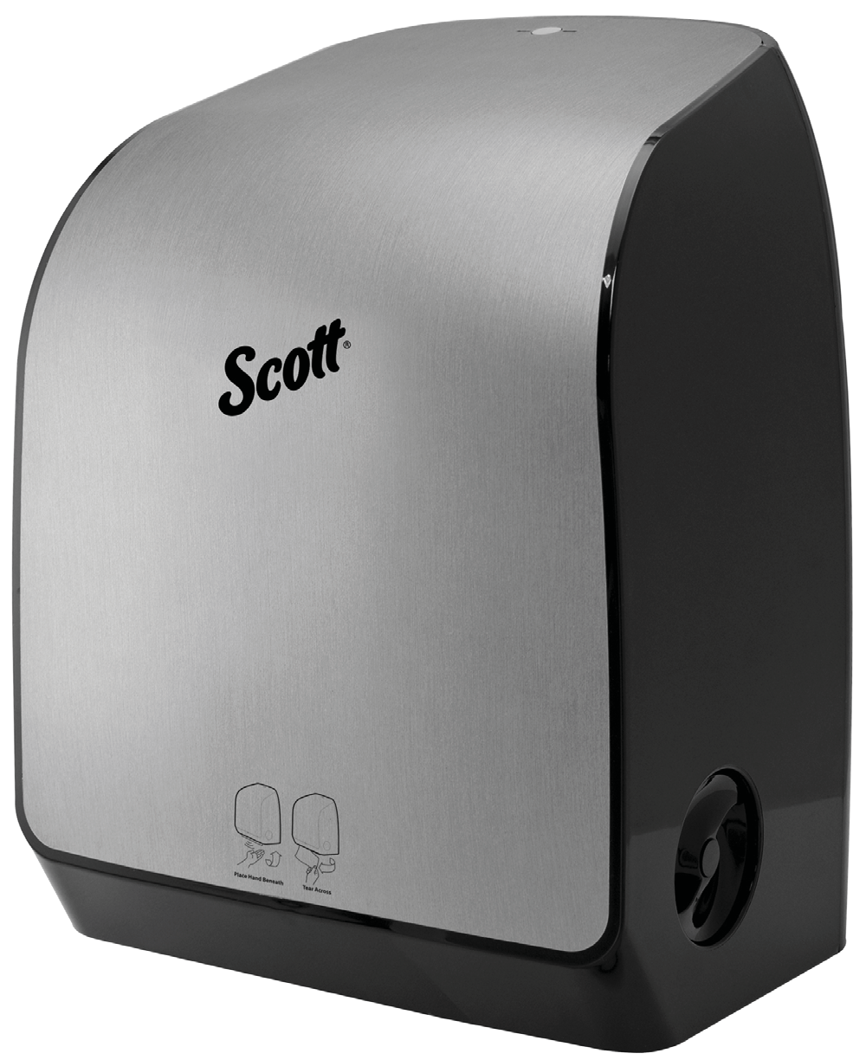
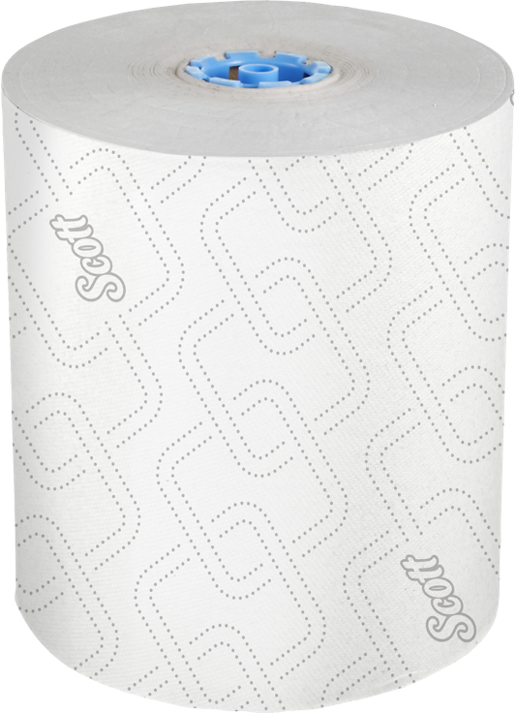
Scott® Pro Automatic HRT Dispenser System
End User Overview Deck

Slide 3

Scott® Pro:
Unparalleled Performance
Innovative solutions designed to improve every aspect of the restroom
Increased productivity with an enhanced image
All while managing the bottom line
Notes:
Want to provide an exceptional experience, increase productivity for your cleaning staff and manage your bottom line? Choose Scott Pro Solutions – innovative systems and products designed to improve the restroom experience.

Slide 4

Scott® Pro:
Unparalleled Performance
Alternate Version with stainless steel
Innovative solutions designed to improve every aspect of the restroom
Increased productivity with an enhanced image
All while managing the bottom line
Notes:
Want to provide an exceptional experience, increase productivity for your cleaning staff and manage your bottom line? Choose Scott Pro Solutions – innovative systems and products designed to improve the restroom experience.

Slide 5
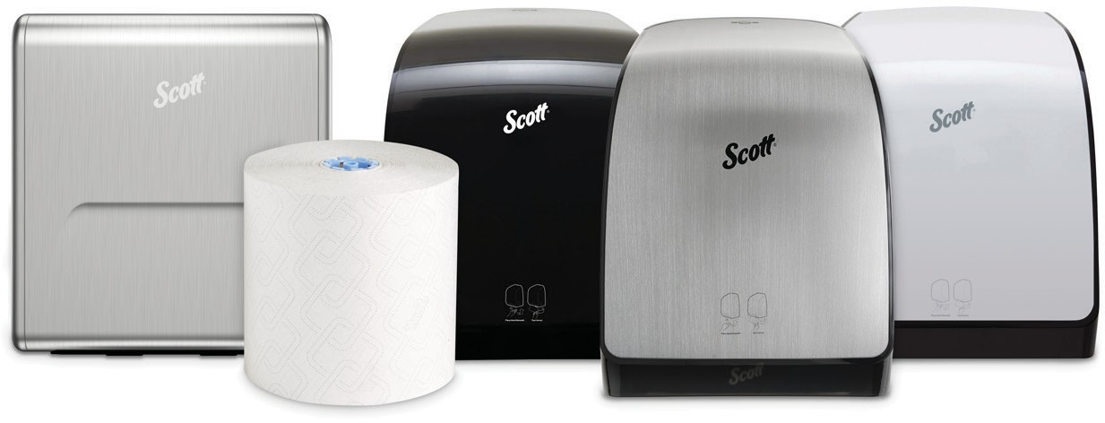






Billions of Hands Dried (and Counting) …and no Jams
Get the dispenser sell sheet
Jam-Free – Guaranteed¹
Flawless since launch – billions of hands dried, without a jam
Hands-free Dispensing
Hygienic mode setting (hidden towel) and touchless dispensing to help reduce the spread of germs
150,000 Towels²
Dispenses 150,000 towels on one set of 4 D-cell alkaline batteries, which equals up to a 5-year battery life
Stress-free Installation
Qualifying accounts can upgrade to the most reliable dispenser system on the market with free professional installation³
Guarantee applies to dispensers installed to Kimberly-Clark Professional specifications and for dispensers utilizing appropriate Kimberly-Clark Professional Scott® Pro Hard Roll Towels. In the unlikely event a jam occurs, please report to your Kimberly-Clark Professional sales representative or contact Customer Service at 1-800-241-3146 and we will troubleshoot the issue until resolved or provide a replacement module or dispenser at no material cost.
With standard issued batteries, lab tested
3. Kimberly-Clark Professional offers free installation for qualified new accounts requiring more than 50 hard roll towel dispensers and only if utilizing Kimberly-Clark Professional towels.
Notes:
The Scott® Pro Automatic hard roll towel system offers complete system benefits as the towel and dispenser were designed to work together hygienically and harmoniously, prioritizing the customer experience and exceeding chooser expectations. All delivered by a KCP stress-free installation experience.
Scott® Pro automatic hard roll towel system: where preferred brand experience meets total reliability.

Slide 6

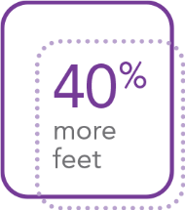

Pair with Quality, Branded, Scott® Pro Hard Roll Towels
Get the towels sell sheet
Unmistakably Scott®
Elevated Scott® Design preferred 4:1 vs. standard towel and tissue products¹
Faster Absorbency
All Scott® Pro hard roll towels have a faster absorbency vs. the competition³
More Feet per Roll
40% more feet on every roll than the leading automatic roll towel system for fewer roll changes²
Towel Options to Meet your Needs
Scott® Pro hard roll towel options including premium quality, maximum productivity or lowest case price.
1. KCP Pattern Preference Study, 2019
2. Vs. Scott Pro High Capacity 1150’ HRT
3. Up to 45% faster absorbency vs. GP Pro 89460. Based on 1 lot of data. Third Party Testing, AAL, February 2021.
Notes:
Key Takeaways
This dispenser works across all 4 towels.
Proprietary Absorbency Pockets™ mean users can take fewer towels to dry their hands thoroughly.
Faster Absorbency v. Competitive HRTs

Slide 7





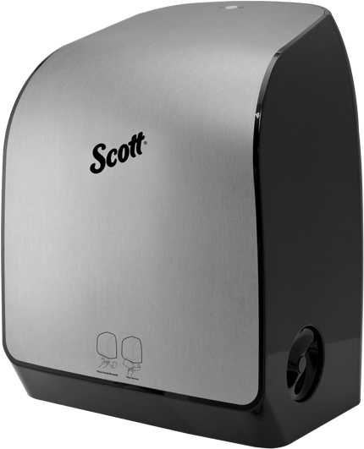
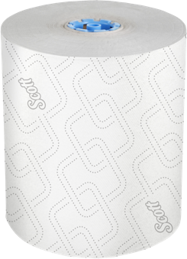
Selecting the Towel that’s
Best for Your Facility
Productivity
Price
Performance
NEW
HRT SKU 1150’
For those looking to maximize productivity – our highest capacity towel
HRT 700’ HRT
Quality towel at a low case price
HRT 700’ Pro Plus
Premium: best absorbency
Elevated Scott® Design preferred 4:1 vs. standard towel
and tissue Products
HRT 900’
Plain White high-capacity hard roll towel
This dispenser works across all 4 towels.
Proprietary Absorbency Pockets mean users can take less towels to dry their hands thoroughly.
Faster Absorbency vs. Competitive HRTs

Slide 8
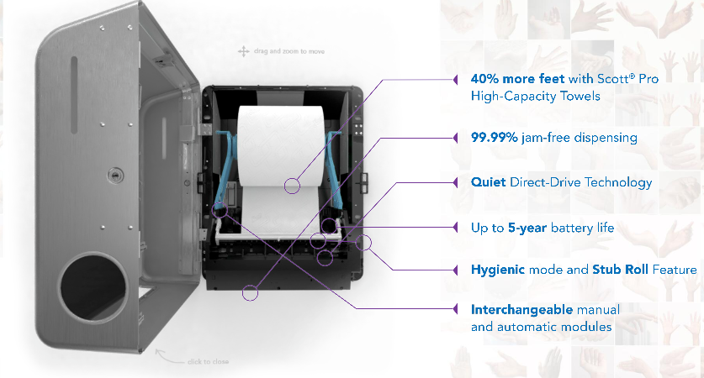
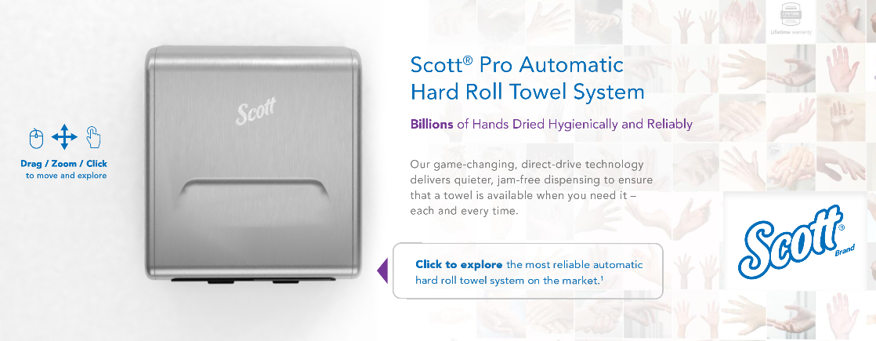

Explore the System with our Interactive Demo
Explore all the benefits in this interactive demo
Notes:
Explore all of the benefits of the system with the interactive demo. Get a look inside the dispenser and click around to learn more about specific benefits that only we can offer. On that same landing page, you will find a short video that highlights the benefits, Scott Pro dispenser and HRT sell sheets, a comparison infographic that highlights how our system beats enmotion as well as testimonials where customers just like you share how they’ve benefited from the Scott Pro aHRT.

Slide 9


Watch How it’s the Most Reliable Towel System on the Market*
*The Scott® Pro Automatic Hard Roll Towel Dispenser offers superior battery life and comparable jam-free dispensing v. the leading competitive proprietary hard roll towels
Notes:
Watch this one minute video where we highlight key features about the importance of having a reliable dispensing system in our hyper-hygiene conscious world.

Slide 10

We’ve Got You Covered for a Lifetime
FAQs
Kimberly-Clark Professional​​ is proud to offer a comprehensive Lifetime Warranty​ on all Scott® and Kleenex® branded towel, tissue and skin care dispensers
We save you valuable time and money through:
Auto-registration
A dedicated customer care team
It’s another example of how the customer
is at the heart of all we do.
† Lifetime Warranty applies to proprietary dispensers while they are installed and the end-user account is exclusively using Kimberly-Clark Professional products for those dispensers. For more information, visit www.KCProfessional.com/LifetimeWarranty
Notes:
We are the only restroom dispenser manufacturer to offer a lifetime warranty. Giving you piece of mind with a Scott brand system you can count on for a lifetime.

Slide 11


Hear First-hand Accounts from Satisfied Customers
First National Bank
Read the full story
One World Trade Center
Read the full story
Watch Video

Slide 12
Get a free upgrade to the most reliable automatic roll towel system¹ on the market and find out how you can save up to 27% annually on hand towels².
Upgrade Now:
See if you Qualify for Free Installation
1. Kimberly-Clark Professional offers free installation for qualified new accounts requiring more than 50 hard roll towel dispensers and only if utilizing Kimberly-Clark Professional towels.
2. Based on the KCP Advantage Saving Calculator, run from August 2020 through January 18th, 2021. Comparing the 1150’ Scott Pro Hard Roll Towel v. competitive hard roll towels

Slide 13
Appendix

Slide 14
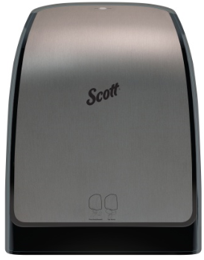
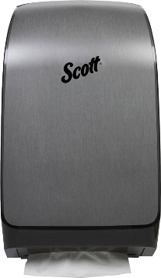

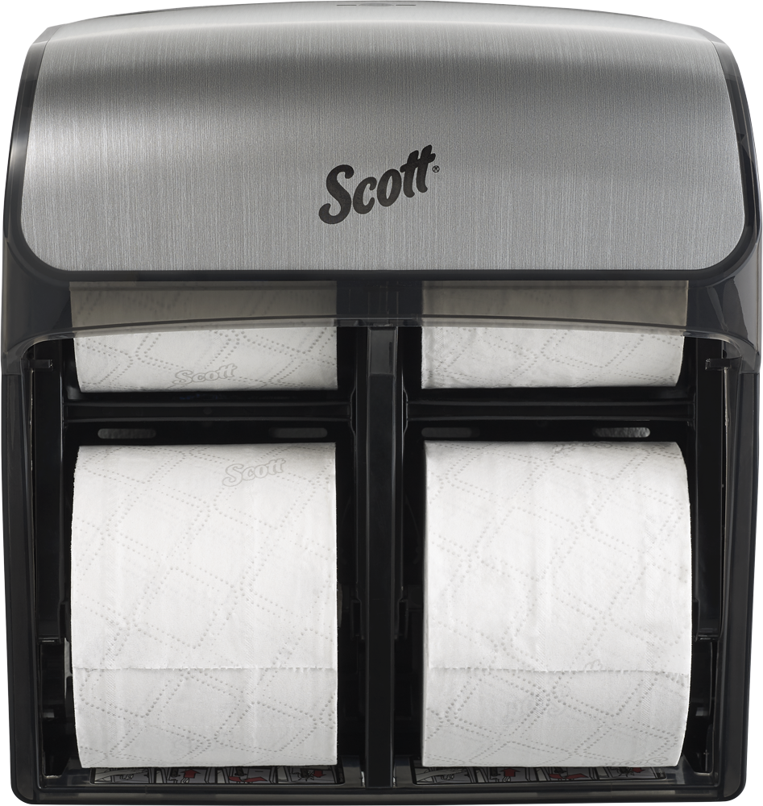
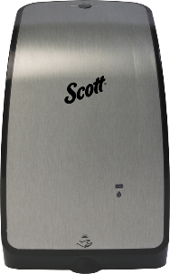
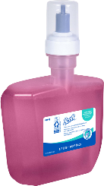

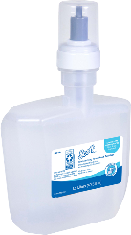
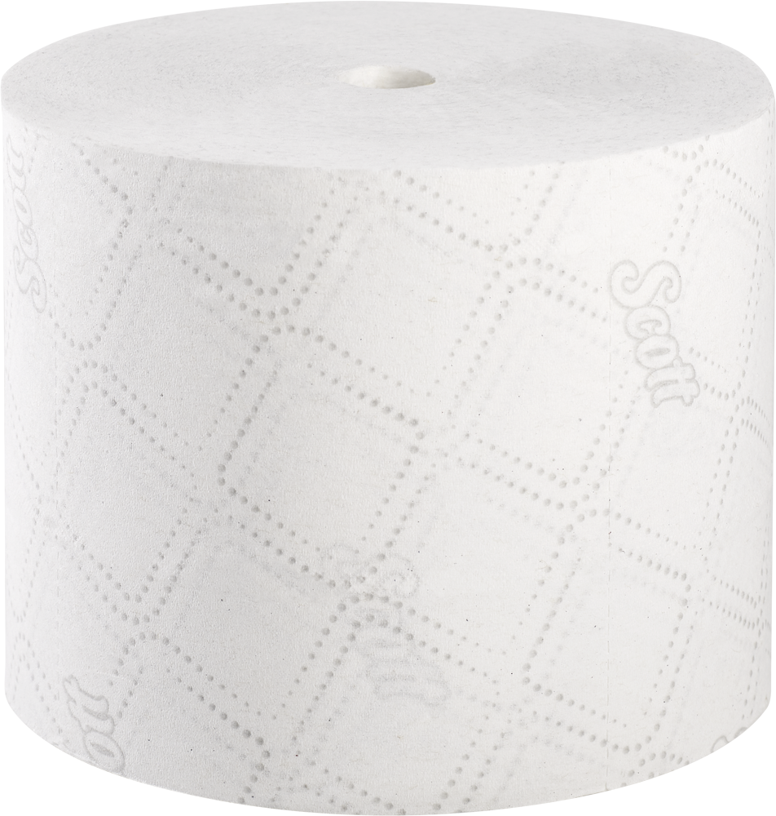
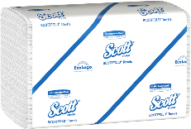
Coordinate your Entire Restroom with the
Scott® Pro Collection
Scott® Pro Hard Roll Towel Systems
Scott® Pro High Capacity SRB Tissue System
Scott® Pro Skincare System
Scott® Pro Scottfold™
Towel System
Kleenex® Facial Tissue
automatic
29739
35609
35614
44519
39712
32508
Manual
29736
35612
35610
21400
47305
91592
01960
25700
25702
25703
91590
Black and white options also available

Slide 15
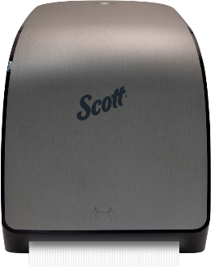
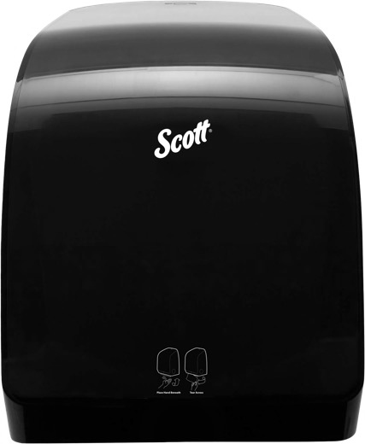
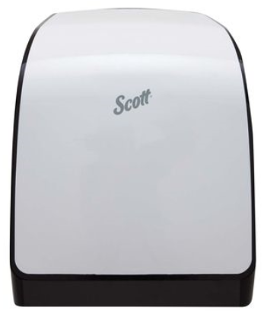
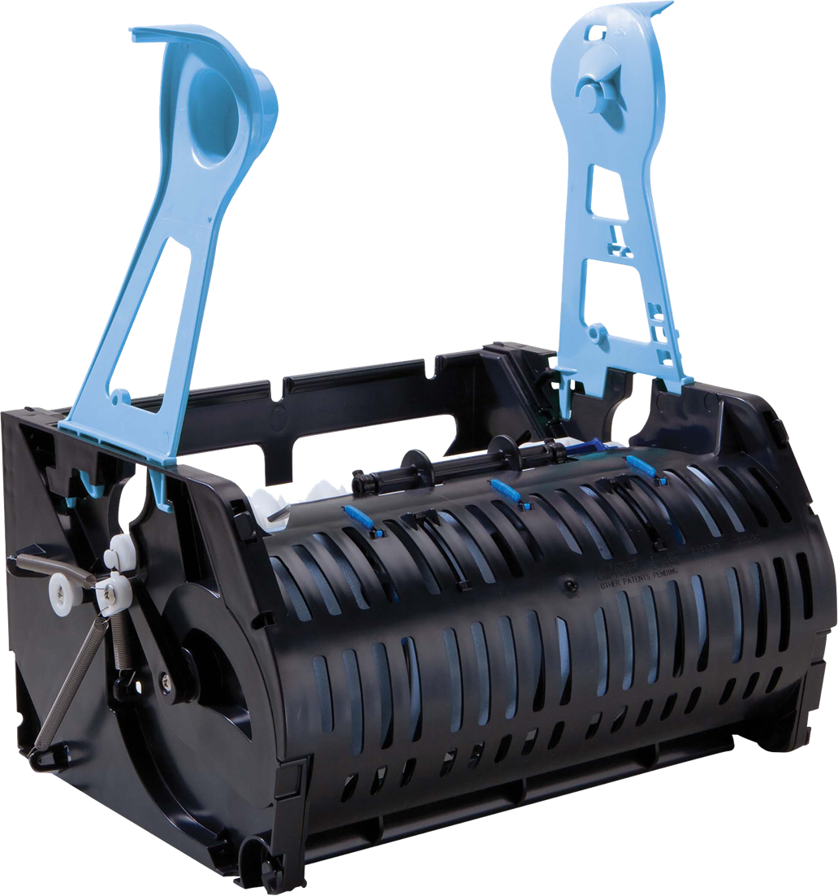
Scott® Pro Automatic HRT Dispensers - green
Dispenser Code | Dispenses Towel Code | Description | Image
29739 | 25700 | Scott® Pro Automatic Towel Dispenser - Faux Stainless
29737 | 25700 | Scott® Pro Automatic Towel Dispenser - Smoke
29738 | 25700 | Scott® Pro Automatic Towel Dispenser - White
31499 | 25700 | Scott® Pro Automatic Module
Notes:
Full suite of options – includes stainless though not shown

Slide 16
Scott® Pro Automatic HRT Dispensers - blue
Dispenser Code | Dispenses Towel Code | Description | Image
35609 | 25702 | Scott® Pro Automatic Towel Dispenser - Faux Stainless
34348 | 25702 | Scott® Pro Automatic Towel Dispenser - Smoke
34349 | 25702 | Scott® Pro Automatic Towel Dispenser - White
34361 | 25702 | Scott® Pro Automatic Module
Notes:
Full suite of options – includes stainless though not shown

Slide 17
Scott® Pro Automatic HRT Dispensers - gray
Dispenser Code | Dispenses Towel Code | Description | Image
35614 | 25703 | Scott® Pro Automatic Towel Dispenser - Faux Stainless
34368 | 25703 | Scott® Pro Automatic Towel Dispenser - Smoke
34369 | 25703 | Scott® Pro Automatic Towel Dispenser - White
34379 | 25703 | Scott® Pro Automatic Module
Notes:
Full suite of options – includes stainless though not shown

Slide 18

Scott® Pro aHRT: the Market Leader
 | Scott® Pro aHRT | GP enMotion® Flex | GP enMotion® Impulse 8” | GP enMotion® Impulse 8” | TorkMatic® H11 w/ Intuition™ | TorkMatic® H1 w/ Intuition™
Dispenser Capacity | 1253’ (1150” + stub) | 1100’ (2 - 550’ rolls) | 700’ | 800’ | 675’ | 850’
Dimensions (H x W x D) | 16.4” x 12.7” x 9.2” | 20.8” x 13.3” x 8.2” | 13.8” x 12.7” x 8.6” | 16.4” x 13.3” x 8.0” | 15.0” x 14.0” x 8.0” | 14.5” x 13.0” x 8.0”
Warranty | Lifetime | 10 Years | 10 Years | 10 Years | No Claim | No Claim
Dispenser Flexibility | Manual & Automatic | Automatic Only | Automatic Only | Automatic Only | Manual & Automatic | Manual & Automatic
Noise (dB) | 46.7 | 55.2 | 55.9 | 55.9 | 62.8 | 62.8
Battery Life | 150,000 dispenses | 200+ rolls | Up to 200 rolls | Up to 200 rolls | No Claim | No Claim
Jam Free | 99.99% | 99.9% | 99.9% | 99.9% | No Claim | No Claim
Ownership | Owned | Lifetime Lease | Lifetime Lease | Lifetime Lease | Lifetime Lease | Lifetime Lease
Scott® Pro Automatic HRT System:
99.99% Jam Free Dispensing¹
99.99%
Quietest on Market¹
1. Kimberly-Clark Professional lab testing, 2019
Notes:
The decibel (dB) scale is logarithmic which means the Scott Pro eHRT is actually 50% quieter than the leading automatic roll towel system

Slide 19
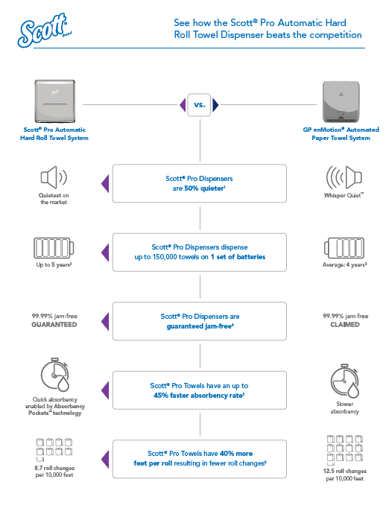
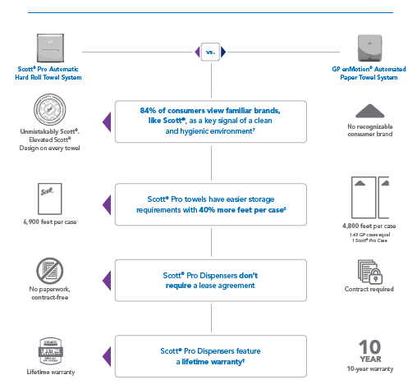
See How Scott® Pro Beats GP enMotion
Get the infographic

