Slide 1
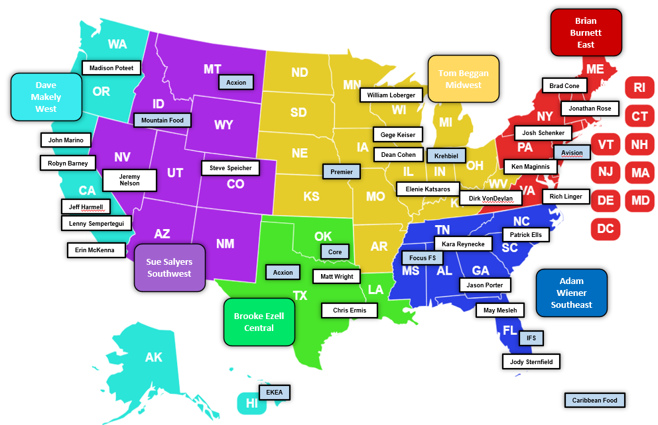
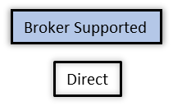
Field Sales & Broker Coverage Map
Brian Lundy
Director, National Field Sales
Brittany Kepple
National Account Manager – Non Commercial
Chris Wood Coordinator – West, Southwest, Central
Dawn Forseth
Coordinator – Midwest, Southwest
Brenda Birling
Coordinator -East

